Slide 1

IT
2 курс

Slide 2
https://docs.google.com/spreadsheets/d/175jk6VXJKr9upU94cl94tozoV06pIKmGRe47vrh_FP8/edit#gid=0

Slide 3
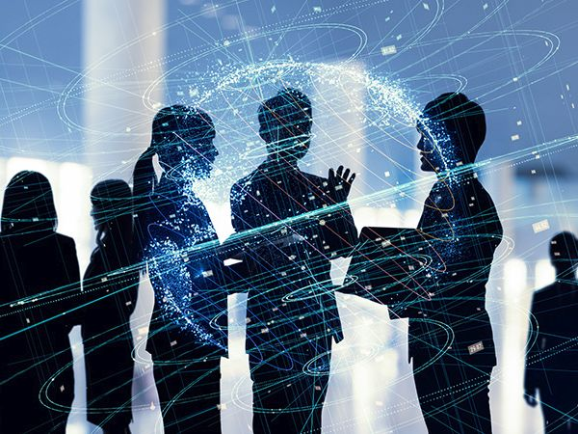
What are your expectations for the future term?

Slide 4
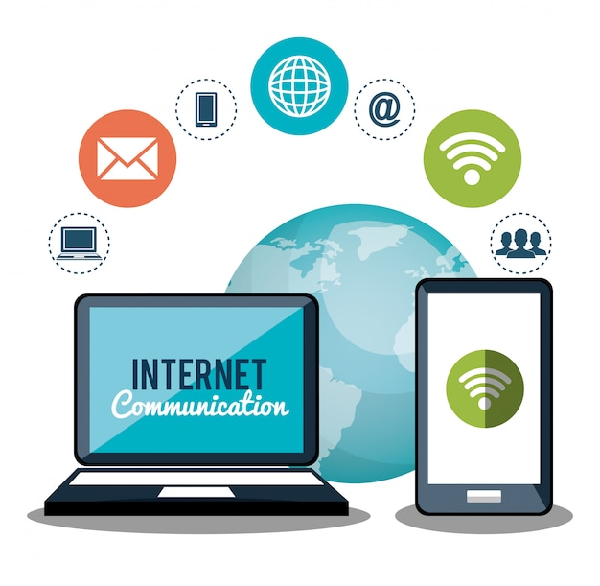
UNIT 1.
THE INTERNET

Slide 5

Task 1. Lead-in questions
1. When do you think the Internet appeared?
2. How has the advent of the Internet changed our life?
3. How can we get access to the Internet?
4. What types of Internet connections do you know?
STUDY BUDDY

Slide 6

Task 5. Watch a video on different types of Internet access at and fill in the gaps in the
sentences below.
1. Cable Internet is a _________ access technology that uses a cable modem with an ______ coaxial cable.
2. Internet Service Providers offer different packages that _________ in speed.
3. A modem with a Wi-Fi router combo is often referred to as a _________.
4. The _______ of the cable Internet is that you have to share a pool of bandwidth with your neighbors.
5. One shouldn’t _______ DSL with the older and slower _______ _______which also uses phone lines.
6. Everyone using DSL has their own _________ connection, so you don’t have to share bandwidth with your neighborhood.
7. The three types of DSL connections mentioned in the video are ADSL, _______ and ________.
8. Fiber-optic cable is used as the _________ of the Internet.
9. Signals in a copper cable can be affected by _________ _________ which can weaken the signal.
1. high-speed; attached
2. vary
3. gateway
4. downside
5. confuse; dial-up connection
6. dedicated
7. SDSL; VDSL
8. backbone
9. electromagnetic interference
https://www.youtube.com/watch?v=qQYiwmamq38

Slide 7

TEXT A. How to get access to the Internet
Read the text and find key information about DSL, Cable Internet, Fiber-optic Internet and Wireless connection.
Follow the link.
https://docs.google.com/spreadsheets/d/175jk6VXJKr9upU94cl94tozoV06pIKmGRe47vrh_FP8/edit#gid=0

Slide 8
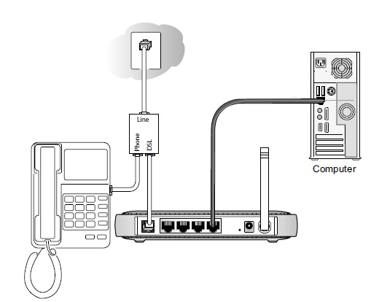
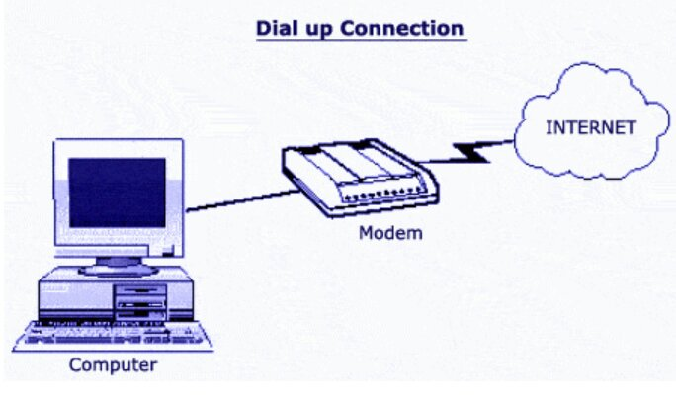
DSL
Digital Subscriber Line (DSL) is a high-speed Internet connection, which utilizes the standard telephone lines, but allows digital signals to be carried rather than analogue.
It allows the full bandwidth of the copper twisted-pair telephone cabling to be utilized.
The DSL signal is pulled out from the phone line as it enters the premises and is wired separately to a DSL modem.
DSL service can be delivered simultaneously with wired telephone service through the same telephone line since DSL uses higher frequency bands for data transmission.
The most commonly installed DSL technology for Internet access is ADSL (Asymmetric Digital Subscriber Line).
It is asymmetric because the download speed is faster than upload speed.
DSL-based services are a low-cost option when compared to other solutions offering similar bandwidth, so they can be made available to customers at extremely competitive prices.
Although DSL makes use of telephone cabling, it should not be confused with the dial-up connection of yesteryear.
A dial-up connection to the Internet was set up by dialing a phone number, hence the name.
Since the same frequency is used to carry voice and data signals over the copper telephone wire, only one service could be provided at a time and it was impossible to use the phone to make calls and browse the Internet at the same time.
A
/ˈæn.ə.lɒɡ/
/ˈjuː.təl.aɪz/
= used

Slide 9
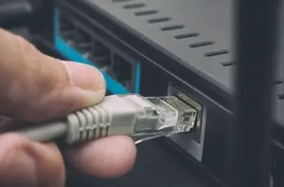
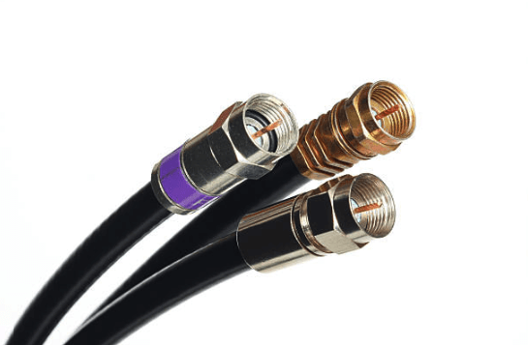
Cable Internet
Cable Internet is a form of broadband Internet access that uses the infrastructure
of cable TV networks to provide Internet services.
It is integrated into the cable television infrastructure analogously to DSL, which uses the existing telephone network.
Since TV itself takes up only a small portion of the cable’s bandwidth, it leaves room for Internet access to be provided through the same network.
First, your Internet Service Provider sends a data signal through the coaxial cable into your home — specifically, to a cable modem.
The cable modem then connects to your computer and other devices via an Ethernet cable or through Wi-Fi network using a Wi-Fi router.
A cable connection is highly reliable and is not subject to outages due to storms, like satellite Internet.
However, since residential cable Internet access is provided through shared bandwidth, which everyone in the neighborhood uses, the speed can be slower during peak usage hours when a lot of Internet users are online.
This does not happen with a DSL network, which keeps a consistent Internet signal because each subscriber has their own dedicated line.
/əˈnæl.ə.ɡəs/
coaxial cable

Slide 10
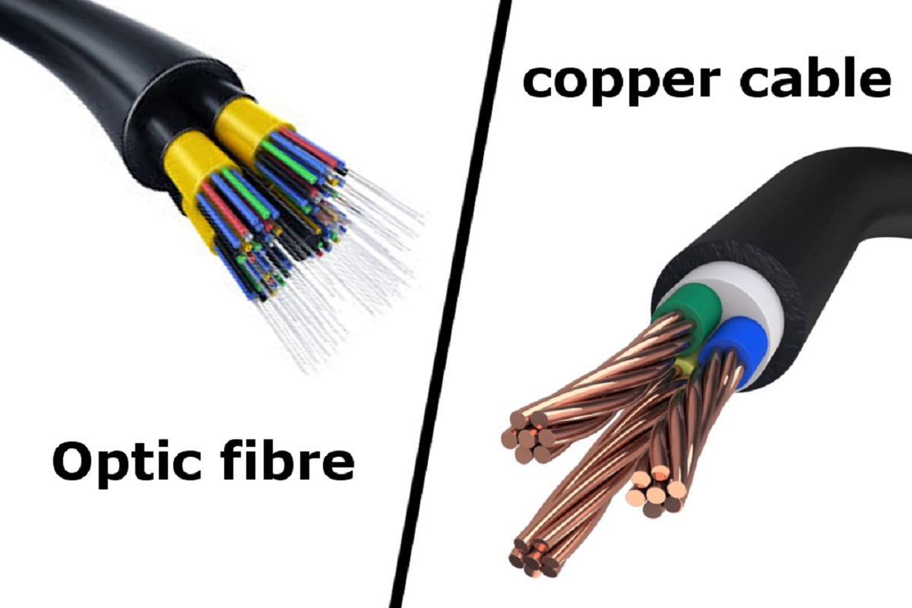
Fiber-optic Internet
Fiber-optic Internet uses fiber-optic cables instead of copper wires and it is incredibly fast.
Those cables send data to and from a computer by harnessing the power of light and can carry data over long distances with low attenuation and distortion of the light signal.
That light signal uses binary system to communicate with computers.
The presence of light indicates a binary one and the absence of light indicates a binary zero.
Fiber-optic cables transfer data faster than copper wiring, which means faster load times and higher-quality streaming.

Slide 11
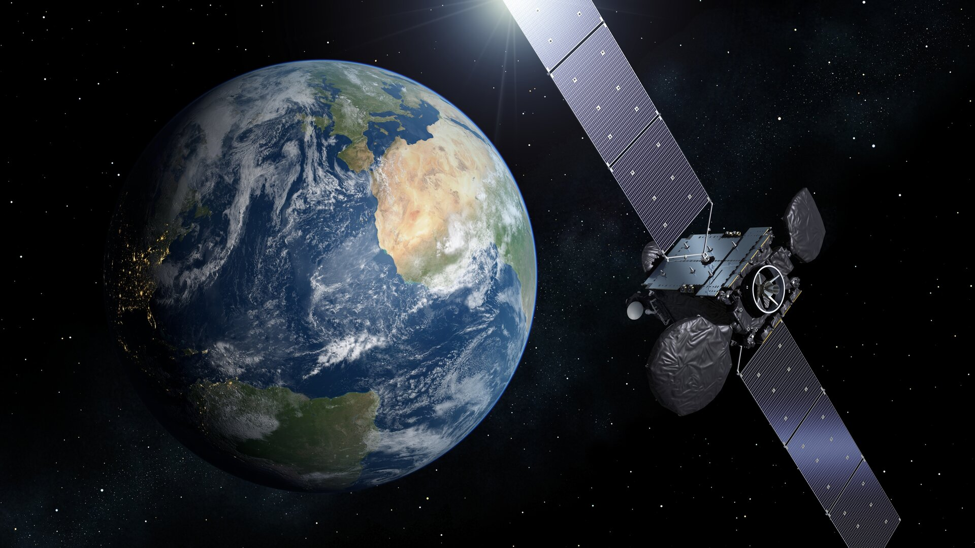
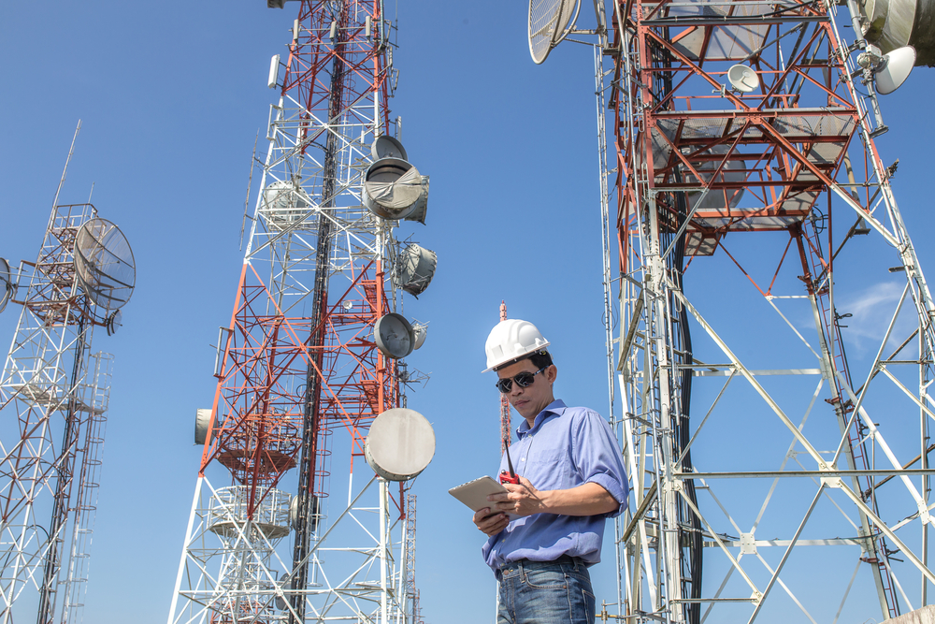
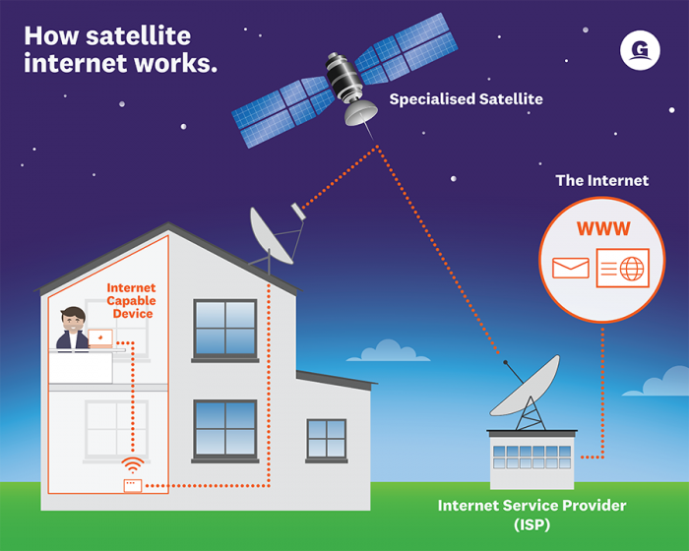
/ˈsel.jə.lər/
/ˈsæt.əl.aɪt/
Wireless connection
The three wireless technologies widely used today are Wi-Fi, cellular and satellite Internet.
Wi-Fi uses radio waves to wirelessly connect devices and is commonly applied for local area networking.
To get access to the Internet, a device (a tablet or a smartphone) has to be connected over Wi-Fi to a wireless router.
Internet over Satellite usually allows a user to access the Net via a geostationary satellite that orbits the Earth.
As signals must travel long distances from the Earth up to the satellite and back again, it may cause a delay between the request and the answer.
However, modern technologies make it possible to minimize this latency.
Thus, satellite Internet access can provide high-speed Internet where the conventional cable or DSL is either not available or not functioning well.
To get access to the Internet, one needs a satellite dish for two-way (upload and download) data communications and a modem.
A cellular network is a communication network distributed over land areas called "cells".
Each cell has at least one fixed-location transceiver, but more commonly, there are three cell sites.
These base stations (cell towers) provide a cell with the network coverage, which can be used for transmission of voice and data.
A cell typically uses a different set of frequencies from the neighboring cells to avoid interference and provide guaranteed service quality within each cell.
/dʒiː.əʊˌsteɪ.ʃən.ər.i/
geostationary satellite that orbits the Earth

Slide 12
Task 3. Read and translate text A. Answer the questions.
1. What does ADSL stand for? Why is this type of connection called asymmetric?
2. What is the difference between a dial-up connection and DSL?
3. What is the origin of the term dial-up connection?
4. What is the downside of cable Internet?
5. What types of wireless Internet connections are mentioned in the text?
6. How is data transferred over fiber-optic cables?
7. What equipment does one need to get access to the Internet through satellite systems?

Slide 13

Task 4. Find English equivalents for the following words and expressions in the text:
a) одновременно
b) помещение
c) цифровой сигнал
d) конкурентные цены
e) дешёвый вариант
f) надёжный
g) стабильный/ устойчивый сигнал
h) выделенная линия
i) искажение сигнала
j) помехи
a) simultaneously
b) premises
c) digital signal
d) competitive prices
e) low-cost option
f) reliable
g) consistent signal
h) dedicated line
i) distortion of the signal
j) interference

Slide 14

Task 6. Modify the word in brackets so that it fits the gap
Bandwidth
Bandwidth is a term related to digital (1) _____ (communicate).
In fact, bandwidth is (2) ____ (synonym) to the maximum rate of data transfer.
It refers to the exact amount of data that can be carried between two points at a (3) _____ (specify) time period. (4) _____ (general), network bandwidth is expressed metrically in the form of bits per second.
However, the modern networks measure their speeds in millions of bits every second, which is also (5) ______ (refer) to as megabits per second.
(6) ______ (similar), billions of bits every second are referred to as gigabits per second.
While understanding bandwidth, we should note that it is not the only vital factor that affects the (7) ______ (perform) of a digital network.
Other relevant factors like data loss or latency issues may also affect the network and make it seem like a low bandwidth issue.
Bandwidth is highly significant for (8) ______ (determine) how fast a web page loads on a browser.
1. communication
2. synonymous
3. specified
4. Generally
5. referred
6. Similarly
7. performance
8. determining

Slide 15
Task 7. Watch a video at explaining how the Internet works and answer the questions
1. What problem can occur if the Internet signal is sent through a satellite?
2. What do domain names correspond to?
3. What makes the backbone of the Internet?
4. What sort of things does ICANN deal with?
5. What makes data transfer over the Internet efficient?
https://www.youtube.com/watch?v=x3c1ih2NJEg

Slide 16

Task 8. Read the text and fill in the gaps with the word below:
ensures / piece / rerouted / includes / congestion / amount /broken down / destination / reliable / determined
1. amount
2. piece
3. broken down
4. ensures
5. congestion
6. rerouted
7. destination
8. determined
9. includes
10. reliable
In telecommunication, a packet is a small (1) ______ of data sent over a network,
such as a LAN or the Internet. When a user sends a file across a network, it is not
transferred as one (2) ______. In fact, it gets (3) ______ into smaller data packets and
this technology (4) ______ reliable and efficient data transmission. So, if a data transfer
encounters network (5) ______ due to multiple simultaneous transfers, some packets
can be (6) ______ through a less congested path. When the packets reach their (7)
______, they are reassembled into a single file by the computer that receives them.
The packet size is typically (8) ______ by the type of protocol used. Ethernet
packets can be around 1.5 KB, whereas IP packet average size is 64 KB. Similar to a
real-life package having a source and destination, each network packet (9) ______ the
origin IP address, the destination IP address, the number of packets in the entire data
file, and the sequence number to guarantee the (10) ______ data transmission.

Slide 17
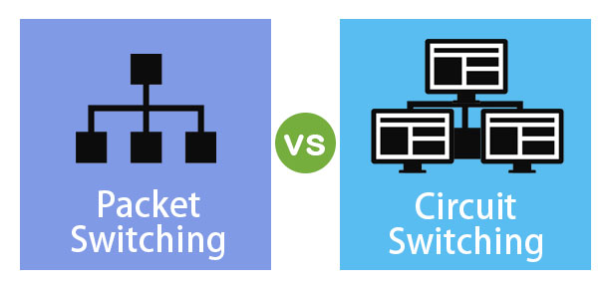
TEXT B. Circuit switching vs. Packet switching

Slide 18

Task 10. Watch a video at and fill in the gaps in the sentences below.
1. hang up; circuit
2. challenges
3. upgrade
4. shared
5. charge; bandwidth
6. common; flexible
1. We’re not able to talk to anyone else or make any other phone calls until we ____
___ with that connection and then we establish a new _____ to someone else.
2. A waste of resources is one of the _______ with circuit switching.
3. ISDN is a bit of an _______ from the telephone, but it is still dialing a phone
number and creating a circuit.
4. Usually the media of packet switched network is _______ by many people.
5. Internet Service Providers generally _______ us based on how much ________
we’re going to use.
6. It’s _____ to see the older circuit switched networks being phased out and
everyone migrating to the faster and much more _____ packet switched
networks.
https://www.youtube.com/watch?v=VjqiHLGO2p0

Slide 19
TEXT B. Circuit switching vs. Packet switching
Read the text and find key information about Circuit switching and Packet switching
https://docs.google.com/spreadsheets/d/175jk6VXJKr9upU94cl94tozoV06pIKmGRe47vrh_FP8/edit#gid=0

Slide 20
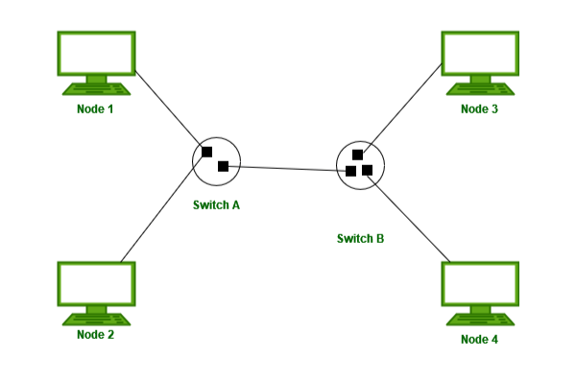
/ˈsɜː.kɪt/
B
Circuit switching is a connection-oriented approach of transferring data units across a network where two network nodes establish a dedicated connection channel before the communication session starts.
This approach of data transmission is a three step procedure that includes connection making, data transferring, and connection removing.
In circuit switching, data is not divided into units, so the complete data is to be transmitted through the same route.
Circuit switching is mainly utilized in public switched telephone networks.
Once you build the circuit, it is in place until you tear it down.
So, no other devices can use this path while it’s reserved even if it’s idle, which leads to a waste of bandwidth.

Slide 21
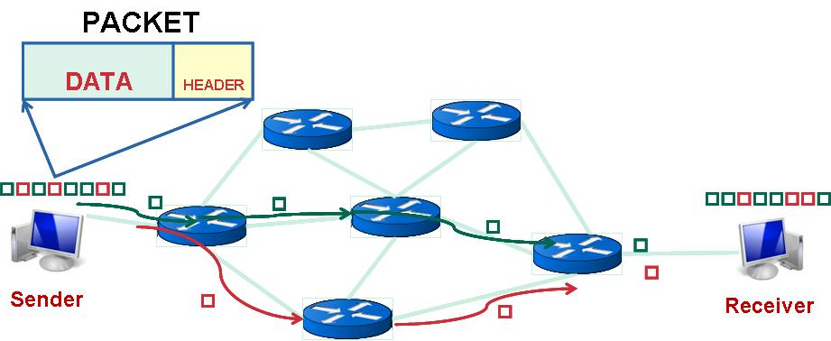
Packet switching refers to a technique where data is divided into multiple units
called packets.
Each packet consists of two main parts: the header and the payload.
The header includes the routing information while the payload contains the data that is to be transferred.
A good example of a packet-switched network is the Internet.
There are two different approaches used for packet switching: datagram packet
switching and virtual circuit switching.
In datagram packet switching technique, there is no dedicated channel for data transmission and packets can be routed individually through different paths.
The packets are later reassembled in the original order based on the sequence number of each packet.
The major advantage of this technology is that it provides a more efficient use of Internet bandwidth.
Virtual circuit switching is a connection-oriented technique that combines the
characteristics of circuit switching and datagram packet switching.
In this type of packet switching technology, a virtual connection is first established between the source and destination and the packets are then routed along this path sequentially.

Slide 22
TEXT C. The TCP/IP model
TCP/IP is a stack of protocols used to interconnect network devices on the Internet.
The entire Internet Protocol Suite is commonly known as TCP/IP because the
foundational protocols in the suite are the Transmission Control Protocol (TCP) and the Internet Protocol (IP).
TCP/IP specifies how data is exchanged over the Internet and how it should be broken into packets, addressed, routed and received at the destination.
The TCP/IP model is widely used today and is compatible with all operating systems and all types of computer hardware.

Slide 23
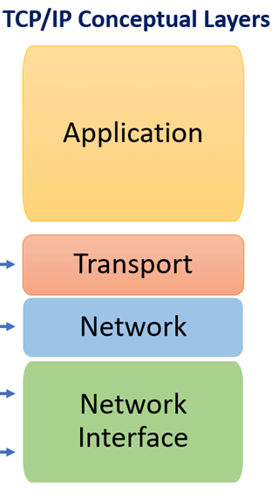
The protocols of the TCP/IP stack are split into four layers.
The Application layer is the topmost layer in the TCP/IP stack and it includes the protocols used by most applications for providing user services or exchanging data over the network.
The most common protocols are HTTP (Hypertext Transfer Protocol) which governs the work of web browsers and websites, FTP (File Transfer Protocol) that handles transmission of files between computers and SMTP (Simple Mail Transfer Protocol) used for emails.
/ˈhaɪ.pə.tekst/
/ˈtræns.fɜːr/

Slide 24
The next layer down is called the Transport layer. It performs host-to-host communication, providing a channel for data transmission between devices. The transport layer protocols include TCP and UDP (User Datagram Protocol).
Transmission Control Protocol guarantees the delivery of data through an acknowledgement and ensures the transmission of missing packets if needed.
Unlike TCP, UDP does not verify the connection between the receiving and sending hosts.
This protocol is used when we need real-time communication, for example when making phone calls.

Slide 25
The Internet layer includes the protocols which are responsible for the logical transmission of data over the entire network.
The primary protocol of this layer is Internet Protocol (IP) which defines how to address and route each data packet to make sure it reaches the right destination.
To this end, both the origin and destination IP addresses are attached to the packet.
Each gateway computer on the network checks the IP address to determine where to forward the message.
The bottom layer of the TCP/IP model is the Network Interface layer.
It includes the protocols required to deliver data across some physical medium.
The best known protocol of this layer is Ethernet, which is frequently used in LAN environments, such as offices, homes, and universities.

Slide 26

Task 12. Fill in the gaps with prepositions:
of / to / as / at / of / over
1. over
2. of
3. to
4. at
5. as
6. of
1. Data is transmitted in small chunks called packets so that they can individually
take the quickest route ____ the Internet to reach their final destinations.
2. Satellite Internet providers have the advantage ____ being available in areas
where cable, fiber, and even phone lines don’t reach.
3. The OSI model has seven layers compared ____ four layers of the TCP/IP
model.
4. The switches usually operate ____ data link layer.
5. The TCP/IP model can be used _____ a reference to help understand how
networks operate.
6. The key responsibility ____ physical layer is to carry the data across physical
channels.

Slide 27

Task 13. Fill in the gaps in the text and answer the questions.
The World Wide Web
The World Wide Web (WWW), commonly (1) ______ to as the Web, is an
information system accessible through the Internet where documents and other web
resources are identified by a Uniform Resource Locator (URL). The resources of the Web can be (2) ______ through a software application called a web browser. The Web is a hypertext-based system (hypertext is a text that contains (3) ______ to other documents). You can (4) ______ on keywords or buttons that take you to other pages or other websites. This is possible because browsers understand Hypertext Markup Language (HTML), (5) ______ used to indicate how a web page is formatted and displayed.
The World Wide Web is not (6) ______ with the Internet, which pre-existed the
Web and upon which the Web is built. English (7) ______ Tim Berners-Lee invented the World Wide Web in 1989. He wrote the first (8) ______ in 1990 while employed at CERN near Geneva, Switzerland. The browser was released (9) ______ CERN to other research institutions in January 1991, and then to the general public in August 1991. The Web began to enter (10) ______ use in 1993/ 1994, when websites for general use started to become available. Nowadays the Web serves billions of users worldwide, as it is one of the best resources for (11) ______ information.
1. referred
2. accessed
3. hyperlinks
4. click
5. a set of instruction
6. synonymous
7. scientist
8. web browser
9. outside
10. everyday
11. up-to-date
accessed /
referred /
hyperlinks /
a set of instructions / synonymous /
click /
scientist /
web browser / up-to-date / everyday /
outside

Slide 28
Task 14. Translate the following sentences from Russian into English
1. Спутниковый Интернет является хорошим решением для сельских районов, где нет телефонных линий.
2. Технология Wi-Fi использует радиоволны, чтобы передавать сигнал.
3. Технологии доступа к Интернету постоянно меняются и совершенствуются.
4. Модем преобразовывает цифровой сигнал в аналоговый и наоборот, чтобы данные можно было передать по телефонным линиям.
5. Цифровая абонентская линия является более быстрым вариантом доступа к Интернету, чем коммутируемый доступ.
6. Сотовая сеть использует специальные базовые станции для передачи сигнала.
7. Всемирная паутина является одним из лучших источников последней информации.
8. Оптоволоконный кабель имеет значительные преимущества по сравнению с медным проводом.
9. Протокол передачи файлов (FTP) был разработан для передачи данных между клиентом и сервером.

Slide 29
Task 15. Fill in the gaps with the correct prepositions:
1. DSL service can be delivered simultaneously ______ wired telephone service over the same telephone line.
2. The Internet is a worldwide computer network that transmits a variety ______ data and media across interconnected devices.
3. An IP address is a series of four numbers separated _____ dots, for example: 192.168.2.10.
4. TCP/ IP specifies how data is exchanged over the Internet and how it should be broken down ______ packets, transmitted, and received at the destination.
5. Transmission Control Protocol guarantees the delivery of data _____ an
acknowledgement.
6. Different types of fiber-optic cables are used for long distance
telecommunication, or for providing a high-speed data connection ______
different parts of a building.
7. TCP/ IP Protocol Stack is compatible ______ all operating systems and all types of computer hardware.
1. with
2. of
3. by
4. into
5. through
6. between
7. with
with
between through
of
into
with
by

Slide 30
Task 16. Match the terms with their definitions:
1. A broadband communication technology designed for the use on telephone lines; it allows a single phone connection to be used for both Internet service and voice calls at the same time.
2. A numerical label assigned to every device in a network that uses the Internet.
3. The fastest wired way to access the Internet transmitting information as pulses of light through strands of fiber made of glass or plastic over long distances.
4. A network of documents that works in a hypertext environment, i.e. using text that contains links to other documents.
5. A high-speed broadband access using a coaxial cable to transmit data.
6. The quantity of data that can be transmitted through a network, measured in bits per second.
7. The least expensive but also the slowest way to access the Internet which uses a standard phone line and analog modem. This technology pre-existed the DSL connection.
8. A radio network distributed over land areas called cells, each served by a
fixed-location transceiver, known as a cell tower.
9. An Internet access technology that is considered an alternative to terrestrial communications.
10.A technology allowing huge files to get broken down into smaller data chunks, not transferred in one piece, which ensures reliable and efficient data transmission.
11.A high-speed Internet connection operating over LAN without the use of any cables and whose essential elements are radio signals and a wireless router.
1. DSL
2. IP address
3. fiber-optic technology
4. WWW
5. cable Internet
6. bandwidth
7. dial-up connection
8. cellular network
9. satellite connection
10. packet switching
11. Wi-Fi
satellite connection DSL
fiber-optic technology
IP address
cellular network
packet switching Wi-Fi
dial-up connection WWW
bandwidth
cable Internet

Slide 31
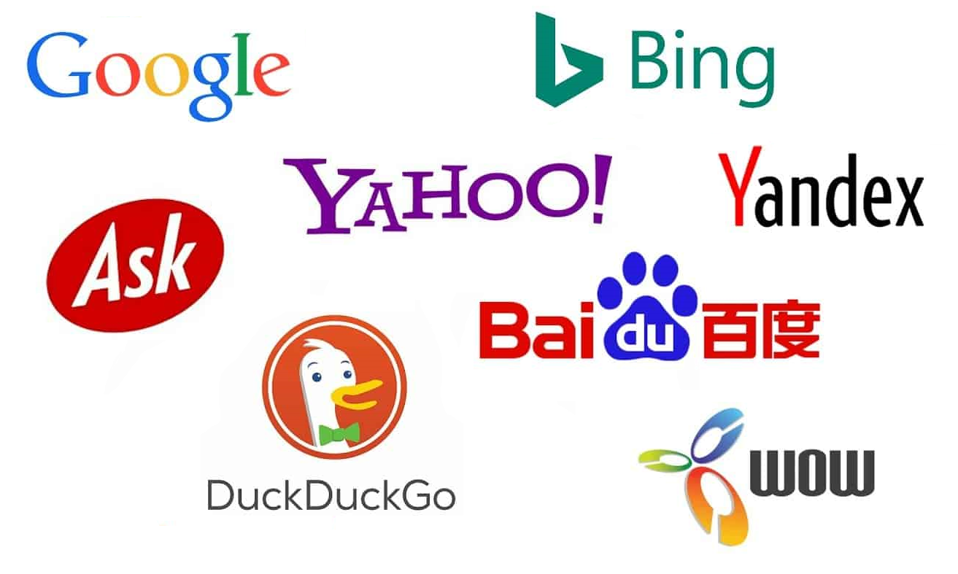
UNIT 2.
SEARCH ENGINES

Slide 32
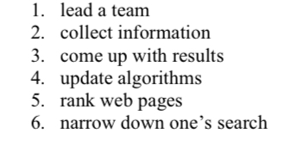
Task 5. You are going to watch a video on search engines.
Match the verbs (1-6) with the nouns or phrases (a-f) to make collocations, then watch the video at and check your answers:
1) lead
2) collect
3) come up
4) update
5) rank
6) narrow down
a) with results
b) algorithms
c) a team
d) web pages
e) one’s search
f) information
https://www.youtube.com/watch?v=LVV_93mBfSU

Slide 33
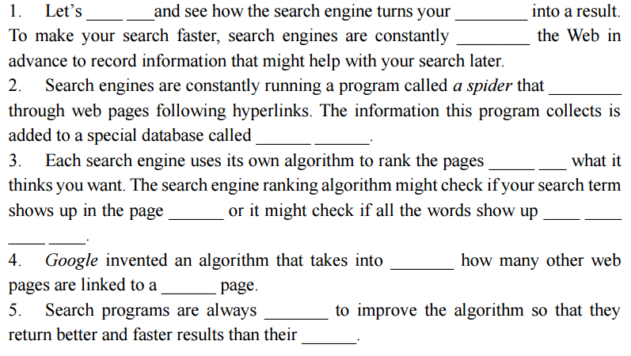
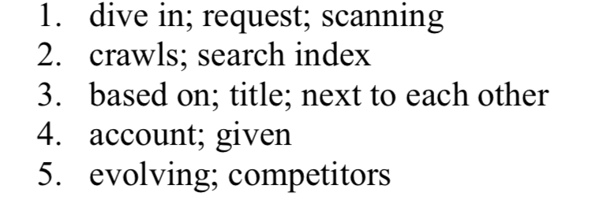
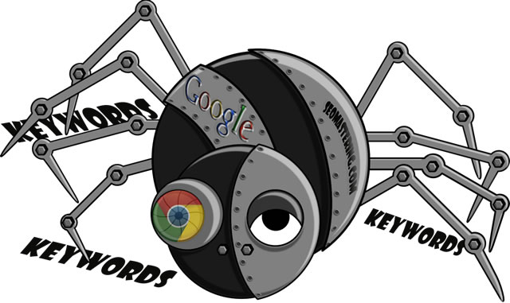
Task 6. Watch the video again and fill in the gaps with the missing words or phrases.

Slide 34
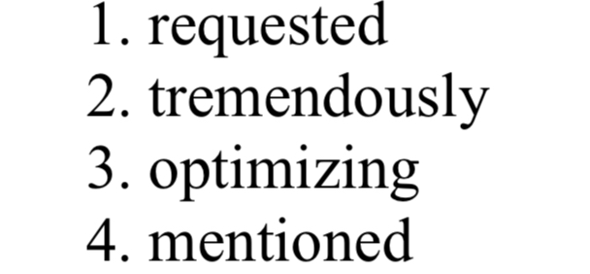
TEXT A. Types of Search Engines
A search engine allows users to extract (1) ______ (request) information from
the huge database of resources available on the Internet. Internet usage has increased (2) ______ (tremendous) in the recent years with the easy to use search engines like Google, Bing and Yahoo! (3) _____ (optimize) websites for Google and other search engines is essential for any website owner if they want to reach a larger audience.
Studies suggest that when using search engines, most people do not go beyond the listings (4) ____ (mention) on the first couple of pages of the search engine results list.
Search engines can be classified into the following three categories:
1) crawler-based search engines
2) human-powered directories
3) meta-search engines.

Slide 35
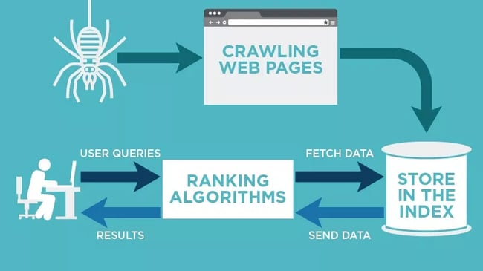
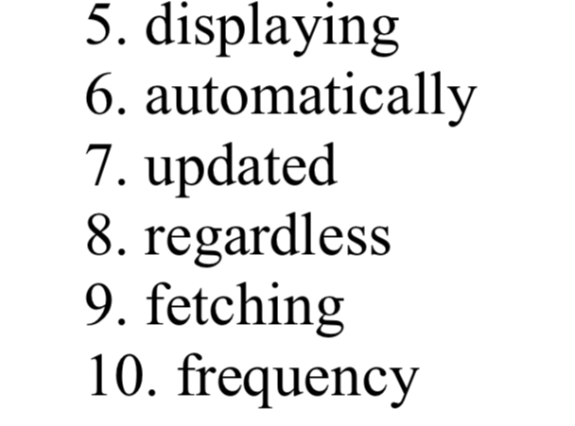
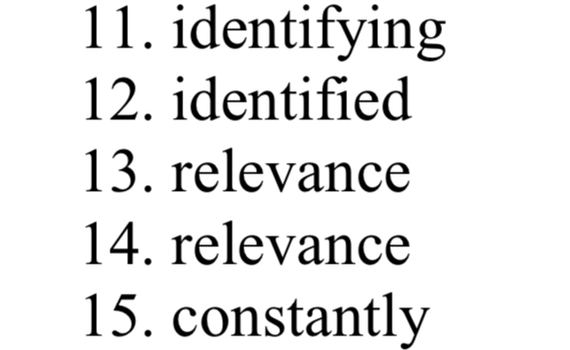
1. Crawler-Based Search Engines
There are three basic steps that every crawler-based search engine follows before (5)
_________ (display) search results: crawling, indexing, ranking
Crawling
Crawler-based search engines create their listings (6) _____(automatic) by using a special program known as ‘a crawler’ or ‘a spider’ to find new and (7) _____(update) content. Content can vary – it could be a webpage, an image, a video – but (8) _____(regard) of the format, content is discovered by links. For example, Googlebot starts out by (9) _____(fetch) a few webpages and then follows the links on those webpages to find new URLs. Various data mining techniques are used to define which pages should be crawled and the crawling (10) _____(frequent). Every time a web crawler finds a new website through a link, it scans and passes its content for further processing (called indexing).
Indexing
Search engines process and store information they find in an index - a massive database of discovered URLs – to be retrieved later when a user enters a query. Indexing is performed by (11) _____(identify) the words and expressions that best describe the page. The (12) _____(identify) words are referred to as keywords and the page is assigned to the identified keywords.
Ranking
Search engines compare the search string with the indexed pages from the database to provide the content that will best answer the user’s query. The results are ordered from most relevant to least relevant. This ordering of search results by (13) _____(relevant) is known as ranking. There are various algorithms to calculate (14) _____(relevant), which is why different search engines give different search results for the same search string. These algorithms are (15) _____(constant) evolving to provide users with most relevant search results.

Slide 36
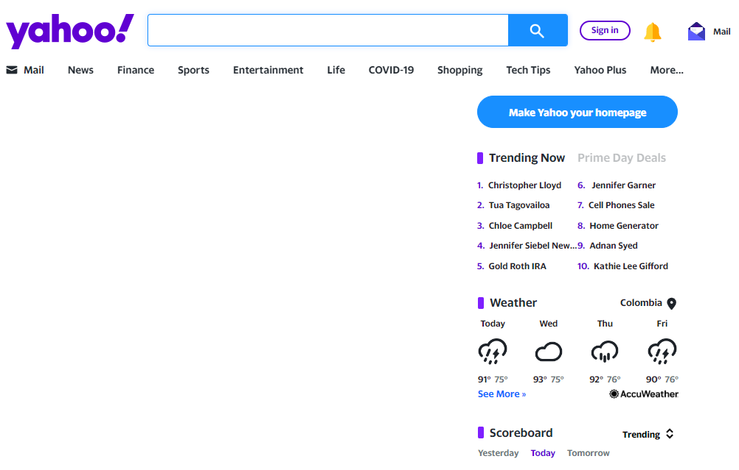
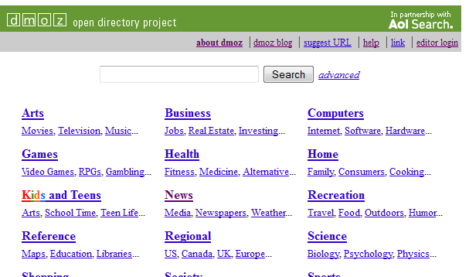
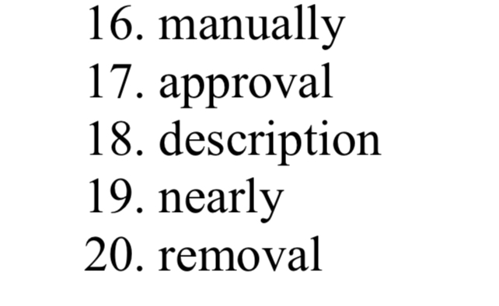
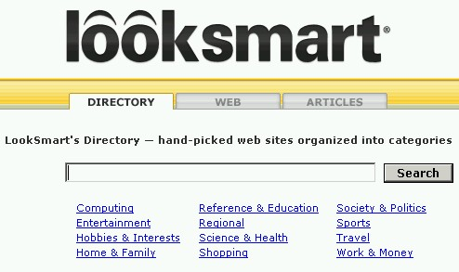
2. Human-Powered Directories
Human-powered directories depend on human editors to compile their listings. This means that they only show results for content that is added (16)____(manual).
There are three basic steps to take.
A short description along with the URL of the website is submitted to the directory for (17) _____(approve).
Submitted site is then manually reviewed and added in the appropriate category or rejected for listing.
Keywords entered in the search box will be matched with the (18) _____(describe) of the site. This means that changes made to the content of a webpage are not taken into consideration as it is only the description that matters.
Yahoo! Directory, Open Directory and LookSmart can serve as good examples of web directories. However, automated search engines like Google, have (19) _____(near) wiped out those human-based directories out of the web.

Slide 37
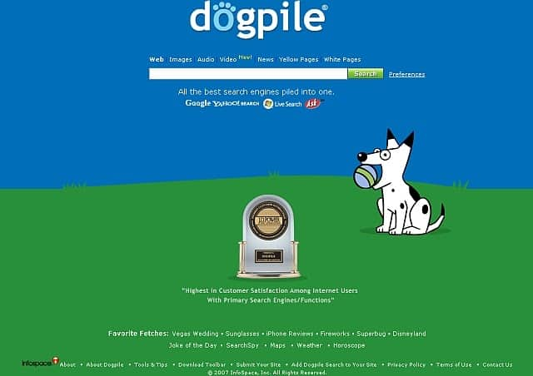

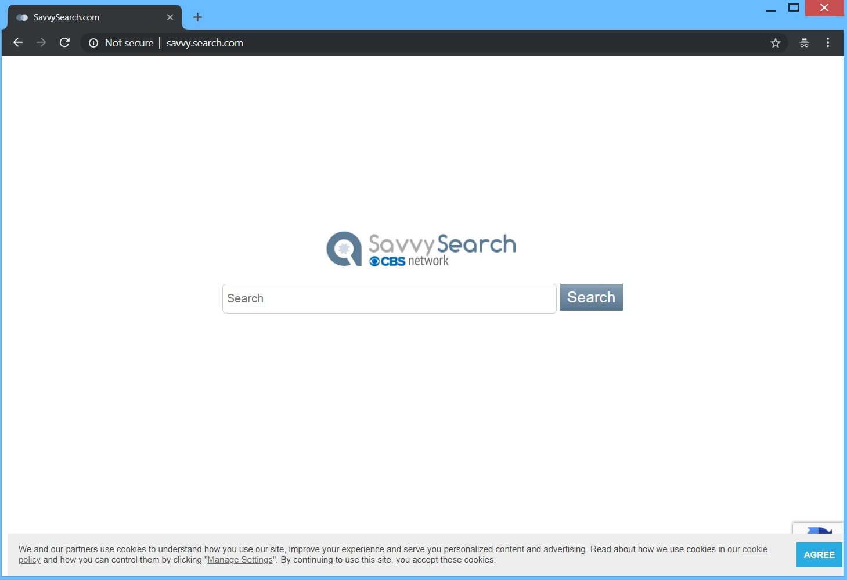
3. Meta-Search Engines
A meta-search engine does not have a database of indexed pages of its own.
Instead, it sends users’ queries to several other search engines and compiles top results from each into one overall list.
After redundancy (20) _________ (remove), these results are processed, ranked and presented to the user.
Dogpile, MetaCrawler, and SavvySearch are a few examples of such meta-search engines.

Slide 38
Task 4. Find the English equivalents to these word combinations in the text:
a) доступный в Интернете
b) перейти по ссылке
c) дальнейшая обработка
d) добавить вручную
e) ключевые слова
f) запрос пользователя
g) поисковая строка
h) иметь значение
i) соответствующая категория
j) принимать во внимание

Slide 39
TEXT B. What are the alternatives to Google?
Google is a globally recognized search engine and an industry giant. But even if it’s the biggest and most well-known, it doesn’t mean it’s your only choice.
One of the main reasons that people choose to use an alternative search engine instead is for increased privacy, as Google is known to track user data both for its own and third - party use.

Slide 40
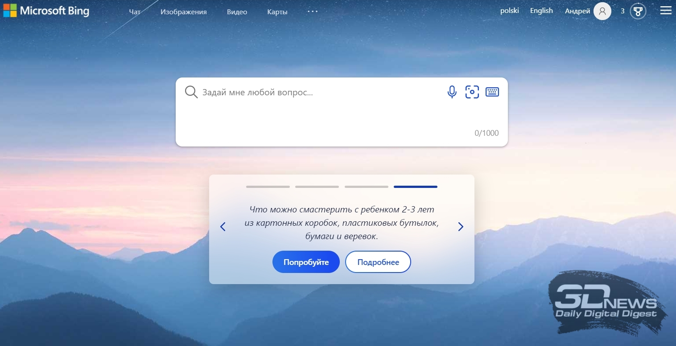
Bing
Microsoft’s Bing has become an alternative search engine option for many people today. It’s easy to use and provides beautiful background photos. Just like Google, Bing is full of (1) _________ like currency conversion, translation, and flight tracking, making it a really (2) _________ that holds its niche in the global market.
While you’re likely familiar with Bing, you might not know that it offers a Rewards scheme. When you shop or search through Bing, you earn points that can be put towards purchasing apps and movies, which is (3) _________. Bing has recently been trying to (4) _________ with Google in the advertising space, adding a number of features to Bing Ads. While Bing doesn’t have the market share that Google does, it is still popular in many markets including the U.S. and the U.K.
internal features / pretty handy / versatile tool / catch up

Slide 41
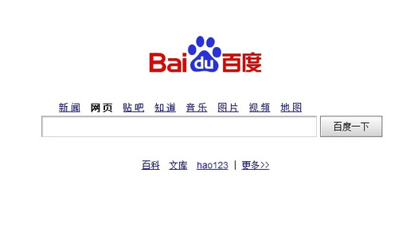
Baidu
Baidu (5) _________ in 2000 and is the dominant search engine in China with a market share of over 70 percent. Although in Mandarin, it is strikingly (6) _________ Google in terms of design. However, Baidu is heavily (7) _________. Certain images and even pro-democracy websites are blocked on the search engine. Outside of China, Baidu holds little influence. But within the country, Baidu powers 3.3 billion searches (8) _________.
The (9) _________ to Baidu is that it only gives access to one market. The upside is that the market it gives access to is huge. That said, it’s crucial for businesses to understand that accessing the Chinese market is not like accessing any other. The visuals, verbiage and customs are entirely different and Google Translate isn’t going to help you win any customers over. To access the Chinese market via Baidu, you need someone on staff who speaks the language and understands the culture.
censored / was founded / similar to / per day / downside

Slide 42
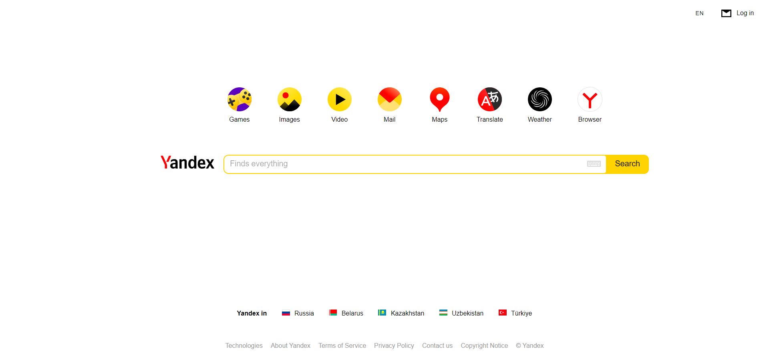
Yandex
Yandex is used extensively in its native Russia, where it (10) _________ around
60% of the search engine market share. It provides a very similar service to Google, and you can search websites, images, videos, and news in a (11) _________ layout. It also has additional features including mobile apps, maps, translation, cloud storage and more.
Yandex has its roots in a project started by two Russian developers to aid in the
classification of patents in 1990. The term Yandex (12) _________ in 1993 standing for “Yet Another iNDEXer.” The Yandex.ru domain was launched in 1997.
In 2011, they (13) _________ on the New York Stock Exchange with an IPO (initial public offering) of $1.3 billion making it the second largest at the time (right after Google). Yandex currently powers more than half of all searches in Russia.
went public / holds / user-friendly /
was adopted

Slide 43
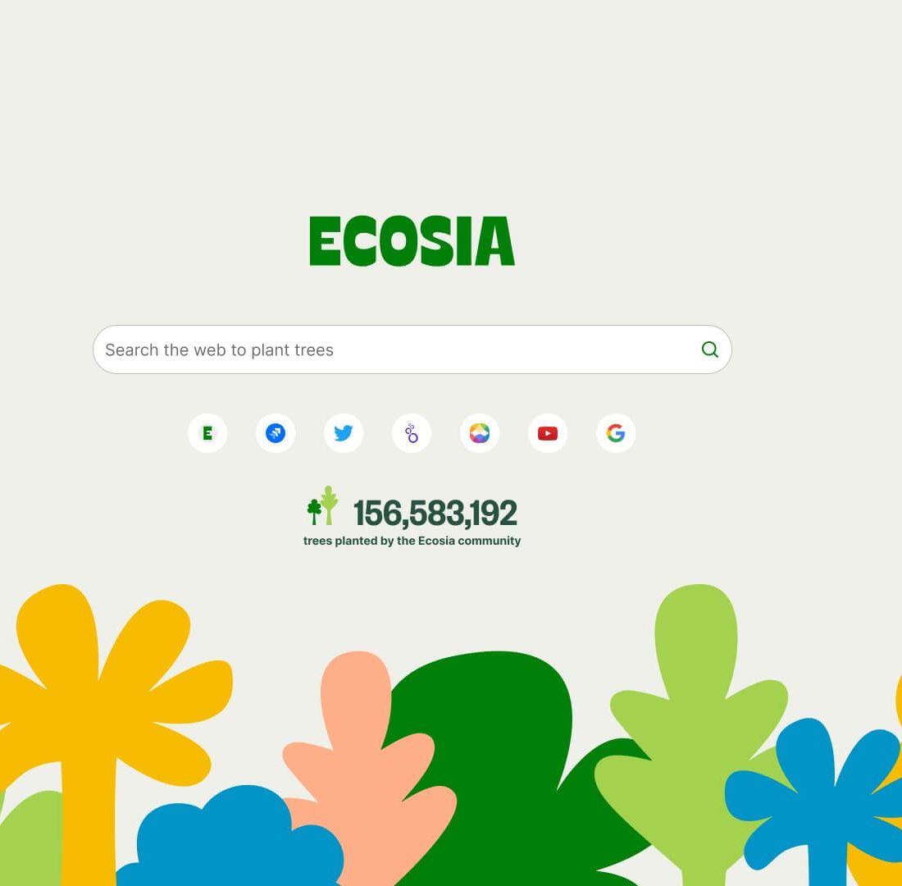
Ecosia
Heavy search engine usage has a considerable impact on CO2 emissions. That is where Ecosia comes in: the CO2 neutral alternative search engine.
Their servers run on 100% (14) _________ and they use their profit to plant trees. About 80% of their ads revenue goes (15) _________ the tree-planting scheme. (16)________, roughly searches are needed to plant a single tree.
towards / renewable energy / on average

Slide 44
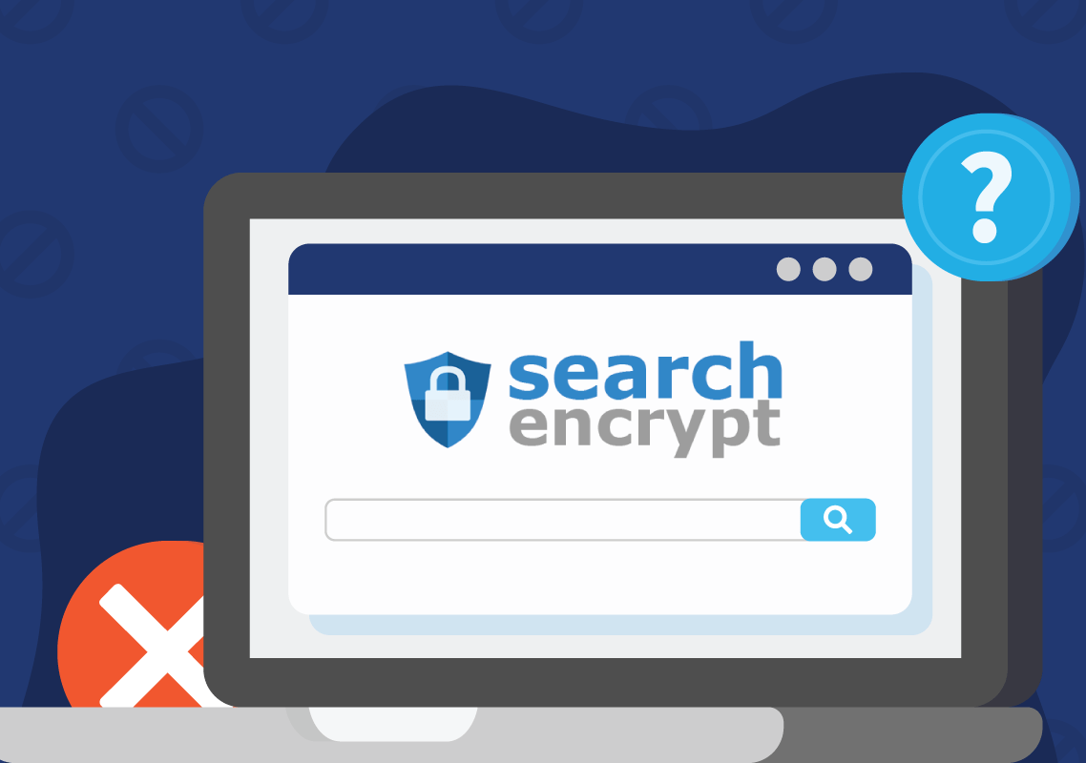
Search Encrypt
Search Encrypt is a privacy-based search engine, which uses (17) _________ to ensure that users’ identifiable information cannot (18) _________. As a metasearch engine, Search Encrypt gets its results from a network of search partners, providing well-rounded results that aren’t personalized to your history. A really interesting feature of this search engine is that it automatically (19) _________ your local browsing history after 15 minutes of inactivity.
This means that you never have to worry about your privacy, even if someone else has access to your computer.
erases / be tracked / encryption

Slide 45
Task 8. Translate the sentences into English.
1. Разные поисковые системы используют разные алгоритмы для сбора и
обработки информации, размещенной в сети.
2. Метапоисковая система – это поисковый инструмент, посылающий запрос
пользователя одновременно в несколько поисковых систем и каталогов.
3. Собрав результаты, метапоисковая система удаляет ссылки, которые
дублируются, и ранжирует результаты поиска в соответствии с
применяемым алгоритмом.
4. Некоторые люди предпочитают использовать поисковые системы, которые
обеспечивают наибольшую конфиденциальность.
5. Поисковые системы ежедневно проводят рутинную работу по поиску,
хранению и сортировке информации.
6. Индексация – это процесс занесения информации в базу данных поисковых
систем.
7. Введя один и тот же запрос в поисковые строки разных поисковиков,
можно получить разные ответы.

Slide 46
Task 9. Watch a video on the difference between a search engine and a web browser at and fill in the gaps below.
1. Unlike a search engine that operates on remote servers, a web browser runs
_______ on your hardware.
2. When you enter a _______ address, a web browser decodes that address and puts
it into a series of _______, so the computer can route traffic to various servers.
3. Besides, a web browser reads the computer code of a website and then
_________ it on the screen.
4. After a user enters a request, a search engine will look across all the websites it
can _____ ____to.
5. With a web browser, a user just points at one _______ website while with a
search engine, a user is given a list of potential places one can go to.
https://www.youtube.com/watch?v=axWqq-IkdVg

Slide 47
TEXT C.
How web browsers work
d. Nowadays, anyone can surf the web, which is a subset of the Internet, using a web browser, like Google Chrome, Firefox or Microsoft Edge. Companies typically make free web browsers because they have financial interest in how you use their Internet connected products.
b. By offering web browsers, they are able to gently sculpt your computing habits and make their other money-making products more attractive. Now let us have a look at how a web browser works. You can get access to multiple websites because there are some standard protocols and procedures.
a. That means they are the same in every website, which allows your web browser to view so many different types of content. So, let us see what happens when you visit a website. At the top of every browser there is an address bar where you can type in the site you want to visit. When you hit the enter button, a chain of actions takes place.
e. First, a web browser has to find the location of a server where the website you want to visit is stored. If fact, a domain name, like youtube.com, represents an IP address. So, the browser then uses a database called the Domain Name System (DNS) to match the domain name you typed in to the corresponding IP address. Next the computer (called the client) and the server where the website is stored establish a connection with each other over the Transmission Control Protocol (TCP).
c. The client sends a request to the server asking if it is open for new connections. If the server is ready to accept a connection, it will acknowledge the request and then, finally, the client sends one more message acknowledging it received the server’s acknowledgement.
f. Now that the connection is established, the client can request web pages over HTTP (Hypertext Transfer Protocol). After receiving the request, the server will go through databases and storage devices to find the information you want and create a response. The response is usually built using HTML (Hypertext Markup Language), which makes the basic building blocks of every website. Finally, the web browser downloads the web page to your computer.

Slide 48
Task 11. Match the terms with their definitions:
1. A special program also known as a spider that finds new and updated content.
2. A massive database of discovered URLs.
3. A program that allows users to extract requested information from the huge database of resources available on the Internet.
4. The address of a file on the Internet.
5. A request that a user enters into a search box.
6. A computer program with a graphical user interface for displaying and navigating between web pages.
7. A field on the screen that accepts typed-in text in order to look up something or launch a search.
8. Ordering results from most relevant to least relevant.
9. A highlighted word or image in a hypertext document that takes a user to another location when he/she clicks on it.
search engine / crawler / browser / hyperlink /
URL / ranking / search bar / index / query

Slide 49
Using the Compunet Browser
The first step to using the Compunet browser is (1) ___ ______ the application.
Locate the browser icon and click it. The browser will open to its (2) _______. The homepage will be the Compunet website. You can change this to any site you (3) _____. At the top of the browser, you will see the address bar. It displays (4) ___ ____ of the webpage that is open. To find a different webpage, locate the search bar. Enter (5) ____ ____ about the idea or pages you are looking for. The webpages you visit are saved in the browser (6) _______. Cookies will also be stored. These two features help load websites faster. You can save any page you visit frequently as (7) _______. Then you won’t have to type in the URLs any more. Compunet’s browser can open multiple (8) _______. But remember that opening too many tabs can (9) ______ with proper functioning. Add-ons are also available to increase the functionality of the browser.
Task 12. Listen to the recording and fill in the gaps in the text below. Audio file 2.1
https://online-edu.mirea.ru/course/view.php?id=7376

